Slide 1



K.RAMAKRISHNAN COLLEGE OF TECHNOLOGY (AUTONOMOUS), TRICHY
PORTFOLIO MANAGEMENT SYSTEM
PRESENTED BY:
2303811724321061 –LOGESHWARAN A
DEPT: AI&DS - 'A'

Slide 2
PRESENTATION OVERVIEW
➢
Abstract
Problem Identification
Objective
Block diagram of proposed system
Machine learning technique used
Advantages of proposed system
➢ ➢ ➢
➢ ➢ ➢
Module Describtion
Module Implementation
Screenshot
Conclusion and Future Enhancement
➢ ➢ ➢

Slide 3
ABSTRACT
This project develops a financial portfolio dashboard using Dash, which visualizes stock data, portfolio metrics, and predictions. It fetches historical stock prices from Yahoo Finance and uses Linear Regression to predict future stock prices. The dashboard includes a pie chart for portfolio allocation, line charts for stock prices, and metrics such as return, volatility, and Sharpe ratio. The app is exposed through a public URL using pyngrok, providing an interactive platform for tracking and forecasting stock performance.

Slide 4
PROBLEM IDENTIFICATION
Investors often struggle to analyze stock data and predict future trends effectively. Existing tools may lack interactive features or predictive capabilities. There is a need for a platform that allows users to visualize portfolio performance, track stock price movements, and forecast future trends based on historical data. This project addresses these challenges by providing an interactive dashboard with real-time data analysis and stock price predictions.

Slide 5
OBJECTIVE
The objective of this project is to create an interactive financial portfolio dashboard that allows users to visualize stock data, assess portfolio performance through key metrics (such as return, volatility, and Sharpe ratio), and predict future stock prices using a Linear Regression model. By leveraging real-time data from Yahoo Finance, the dashboard provides users with an intuitive platform to track historical stock trends, forecast future performance, and make informed investment decisions.

Slide 6
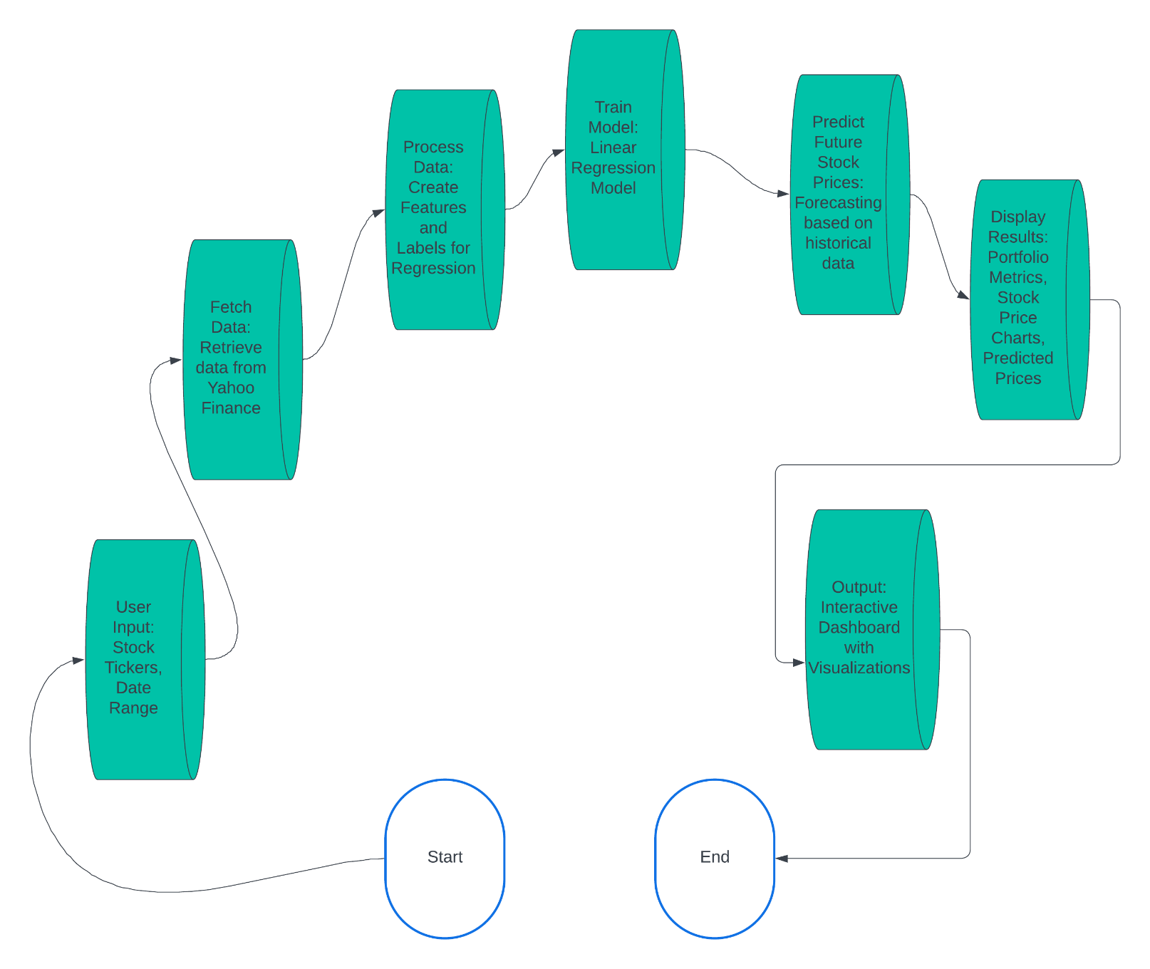
PROPOSED SYSTEM
BLOCK DIAGRAM

Slide 7
MACHINE LEARNING TECHNIQUE USED
Linear Regression: A supervised learning algorithm used to predict future stock prices by modeling the relationship between historical stock data and future trends. It is applied to forecast the next 30 days of stock prices based on past data.
Feature Engineering: This technique involves transforming raw stock data into structured input for the model. In this case, lag-based features (previous stock prices) are created to help the model learn and predict future prices more effectively.
Time Series Forecasting: Using historical stock price data to predict future values. Linear regression is applied here as a method for time series forecasting, making predictions based on past trends and patterns in the stock data.
These techniques enable the dashboard to provide stock price predictions and assist users in making informed financial decisions.

Slide 8
ADVANTAGES OF PROPOSED SYSTEM
proposed system offers several advantages:
Real-time Data Visualization: Provides interactive, up-to-date visualizations of stock prices and portfolio performance.
Predictive Analytics: Uses machine learning to forecast future stock prices, aiding in better investment decisions.
User-Friendly Interface: Simple inputs for stock tickers and date range, making it accessible for users with varying technical expertise.
Comprehensive Portfolio Metrics: Displays key metrics like return, volatility, and Sharpe ratio to evaluate portfolio performance.
Remote Access: The app is accessible through a public URL, enabling easy remote access.

Slide 9


Module Describtion
Data Fetching Module: Retrieves historical stock data from Yahoo Finance based on user inputs for tickers and date range.
Feature Engineering & Model Training Module: Prepares data by creating features and trains a Linear Regression model to predict future stock prices.
Prediction Module: Uses the trained model to forecast future stock prices for the next 30 days.
Visualization Module: Displays stock price charts, predicted prices, portfolio metrics (return, volatility, Sharpe ratio), and allocation via interactive visualizations.
User Interface Module: Handles user inputs (stock tickers, date range) and updates the dashboard with results in real-time

Slide 10
Module Implementation
Data Fetching: Uses the yfinance library to download historical stock data based on user-defined tickers and date range.
Feature Engineering & Model Training: Transforms stock data into lag-based features and trains a Linear Regression model for price prediction.
Prediction: The trained model forecasts the next 30 days of stock prices based on the latest data.
Visualization: Uses plotly to create interactive charts for stock prices, predicted values, and portfolio metrics.
User Interface: Built with Dash, allowing users to input tickers and date range, and dynamically update the dashboard.

Slide 11
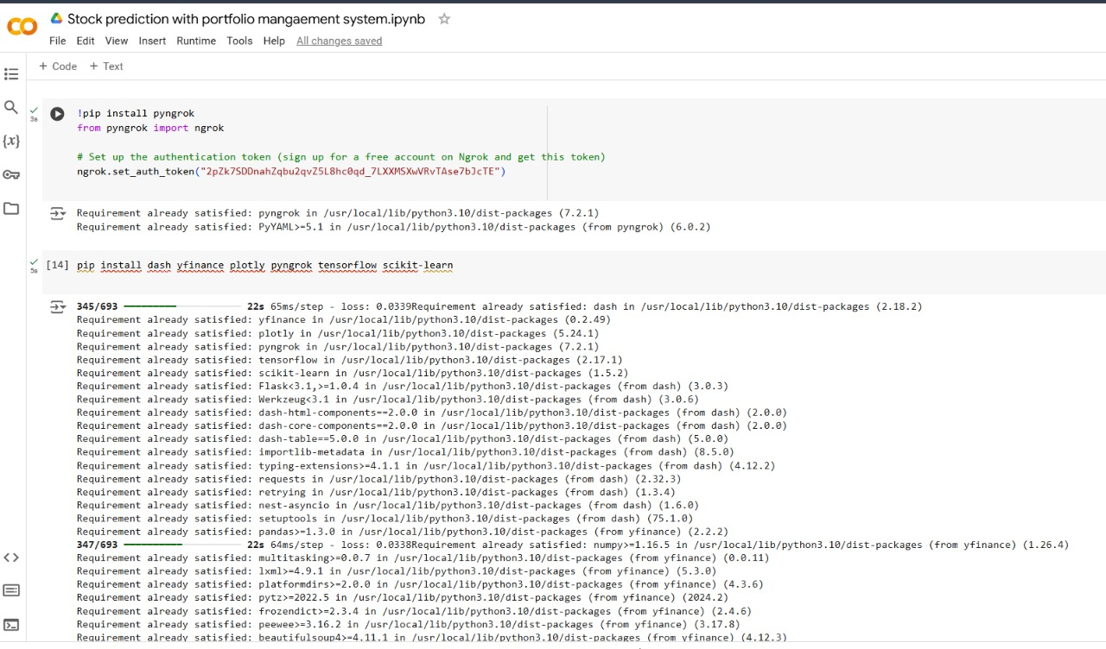
Screenshot

Slide 12
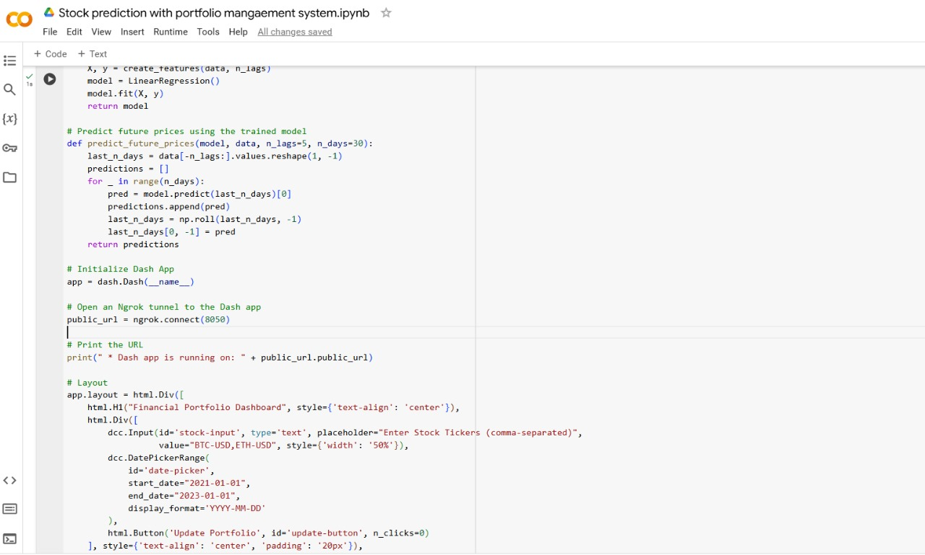
Screenshot

Slide 13
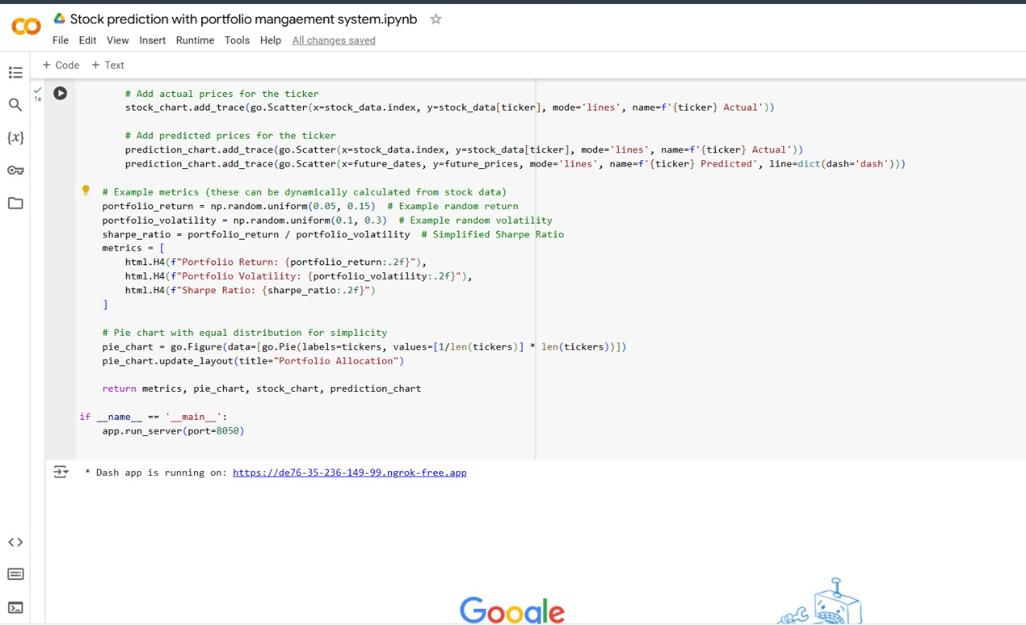
Screenshot

Slide 14
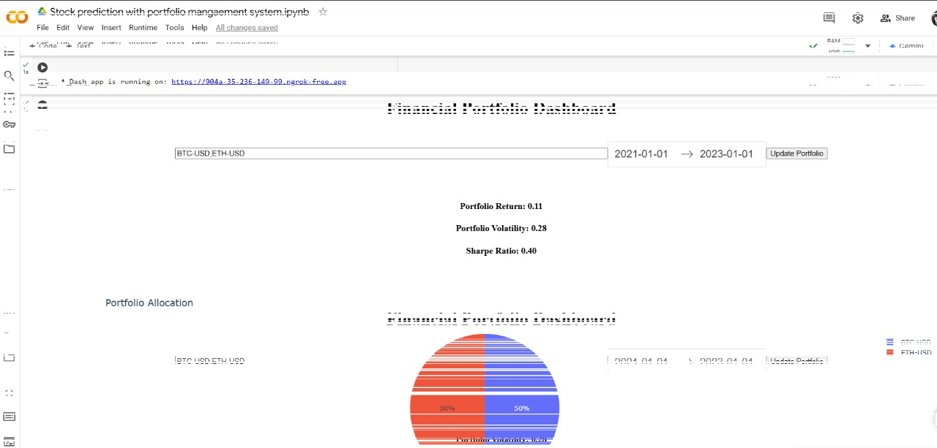
Screenshot

Slide 15
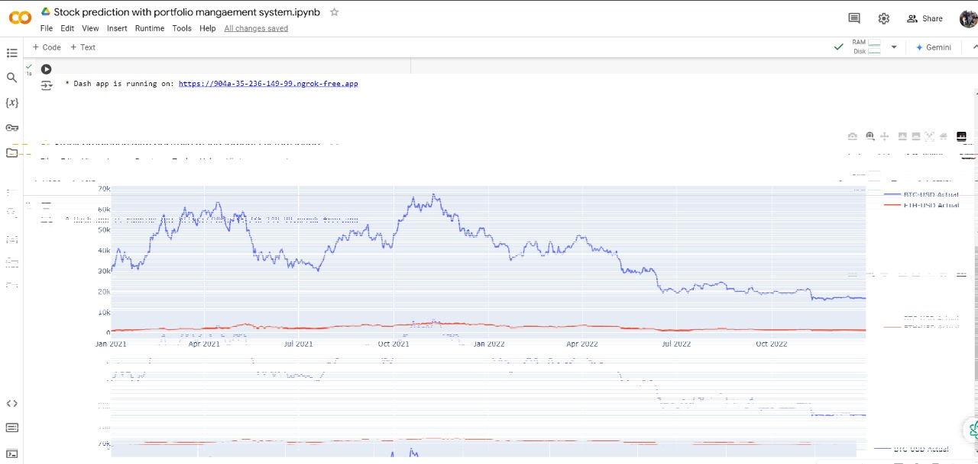
Screenshot

Slide 16
Conclusion and Future Enhancement
Conclusion
The proposed system provides an interactive financial dashboard that visualizes stock data, calculates portfolio metrics, and predicts future stock prices using Linear Regression. It offers real-time insights, aiding users in making informed investment decisions.
Future Enhancements
Advanced Prediction Models: Implement more sophisticated models like ARIMA or LSTM for better accuracy in time-series forecasting.
Real-Time Data Integration: Incorporate live stock data updates for continuous monitoring.
Portfolio Optimization: Add features for dynamic portfolio adjustments based on predicted performance and risk factors.
User Customization: Allow users to set specific criteria for prediction models and metrics.

Slide 17
THANK YOU

